Slide 1
Tanks
Do It Tomorrow
Conor Sargent
Daniel Hogan
Colm Mulhall

Slide 2
Team Roles
Conor Sargent – Team Leader, Lead Designer, Tester
Daniel Hogan – Lead Coder
Colm Mulhall – Secretary, Tester

Slide 3
Goals
When we found we got the “Tanks” project, we set out a list of goals that we thought had to be met
We wanted to recreate the game “BattleZone” as best we could
We wanted to modernise it
To learn 3D game programming and design
Competed in Games Fleadh, a games programming competition.

Slide 4
BattleZone
Battlezone is an arcade game that was developed by Atari in the 1980s
The player controls a tank and faces off various enemies such as tanks
The enemies are worth different points

Slide 5
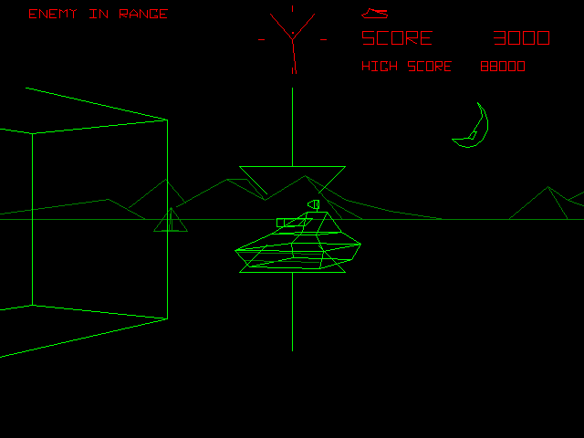
BattleZone

Slide 6
What we did
We managed to recreate the game “BattleZone” with our own personal touches
As time went on, we improved our understanding of 3D Programming
We got great feedback from Games Fleadh and this helped influence the game.
Notes:
Personal touches: Our own version of the radar, our own custom tank, level design
Feedback: Enemy AI

Slide 7
How we did it (Part 1)
We spared no time in trying to recreate the game
The first thing we did was organise ourselves.
We set up a github and Daniel set up basic 3D world
After we got that done, we spent the next couple days adding new features to it
We learnt blender and further improved our understanding of 3D programming
Notes:
Deadline, under pressure.

Slide 8
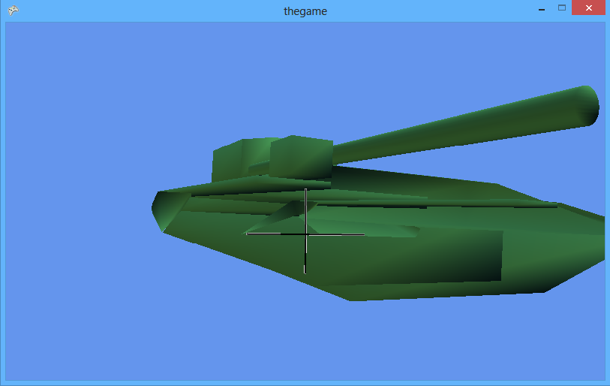
Notes:
Basic world.
Tank scaling wrong
No movement, obstacles, or anything.
Just a camera move around tank

Slide 9
How we did it (Part 2)
As the weeks progressed, we started tackling more complicated elements
This included collision detection, obstacles and radar.
While this was being done, elements from previous weeks were being polished
Design choices were made, such as enemy health, levels etc.
Notes:
Collision detection – hardest part, a week, collision detection for camera
Obstacles – not too hard, Colm did it
Radar – Researched online, 3D points to a 2D axis
Previous week – Conor and Colm would test, come back top Daniel

Slide 10
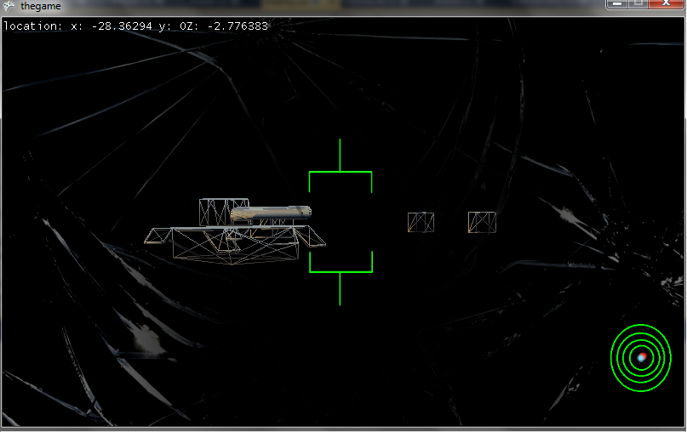
Notes:
First radar, tank model was still being redone, basic obstacles, no scoring, health, AI, testing player health with screen crack

Slide 11
How we did it (Part 3)
As Games Fleadh came up, we had a running version done a lot sooner than we anticipated.
We managed to do this, getting in a very basic A.I. implemented
After the Game Fleadh we sought out to improve the game with the feedback we got from the judges at the competition
Notes:
Feedback – unfinished, it was a very basic prototype
Improve – Fix radar, enemy AI

Slide 12
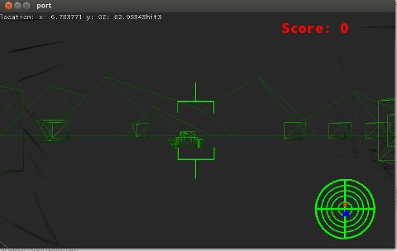
Notes:
Games Fleadh version - background, scoring, radar slightly improved, tank done, obstacles done

Slide 13
How we did it (Part 4)
At this stage, tweaking and finishing touches were added.
This included a better radar, scoring tweaks, level design and modification to the tank model
Final tests were done towards the end
These were, what we considered, big test
More tweaks were done
Notes:
Getting AI and radar working
Getting feedback from testers, bug chasing

Slide 14
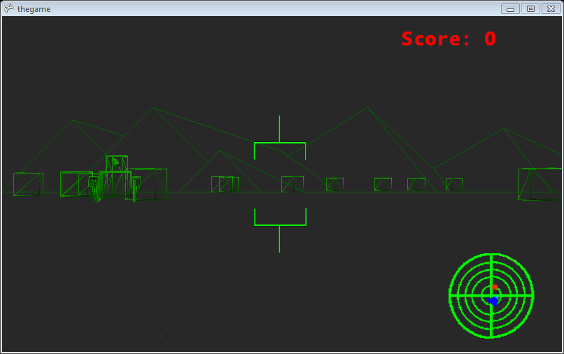
The finished product

Slide 15
Lead Designer
As lead designer, I had to learn about Blender and 3D modelling.
I was mainly in charge of this for about 4 weeks until one of our core members, Rob Lowe, left.
At this point I had to take on sound design as well

Slide 16
Problems
Loading in the model
Scaling was off and I found myself redoing the tank about 3 times
This, combined with a lack of understanding towards Blender, made it quite troublesome
Taking over Rob’s duties
Level design and scoring

Slide 17
Secretary/Designer
I had no experience with game programming in XNA before I started this project.
I had to look through old 2D games to get familiar with the framework.
I also had to learn how to use Blender in order to create the obstacles in the game.
As part of my role as secretary I had to keep all of our documentation up to date.

Slide 18
Problems
Because I had no experience with XNA it took me a long time to get up to date with work on the game.
I spent most of the first few weeks catching up as a result of this.
All the while I was keeping the documentation up to date.
This included all meetings, design documents, and project plans.

Slide 19
Lead Coder
Firstly I had to quickly learn 3D games programming
I was in charge of the of the main code base
Enemy AI
Player movement
Collision detection

Slide 20
Problems
Getting collision detection working
Bounding spheres caused a lot of headaches.
Tank AI
Going from the tank just looking at the player to moving around from point to point.
Radar not showing player direction.

Slide 21
Testing
Testing was a vital part of the project and hard to avoid
Testing was done by Conor and Colm
Every week there was some form of testing involved
Any problems we found were presented to Daniel
During the last two weeks, two big final test were conducted
Notes:
We spotted a few things that needed changing.
These included: more paths for enemies, change to map size where bullets render, changes made to the menu.

Slide 22
Conclusion
We felt that we achieved our goal
We feel like we came out with a good product
We all gained skills from the project
If we had more time we would have implemented more features such as Kinect and animations
Overall we handled the project well, we got along and made something we are proud of
Notes:
We can release for cheap and continue to add things to it.

Slide 23
Questions?

